Slide 1
COVID19 Investment Strategy
Brian Nagle, Wood Walker, Elona Xhikola, Casey Hojecki
Notes:
Still workshopping title
Pandemic Stock Market Analysis
Seemed a bit vague

Slide 2
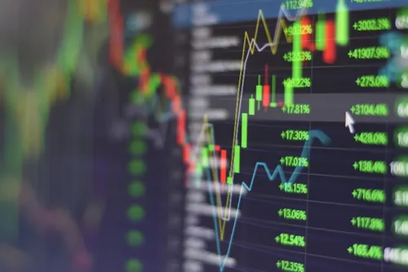
Hypothesis

Slide 3
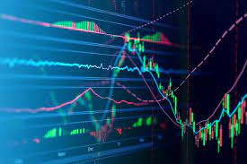
Hypothesis
A simple investment strategy targeting market-standard blue-chip stocks will yield the highest ROI for retail investors during the COVID19 pandemic
Assumed a starting budget of $1000 and monthly contributions of $100
blue-chips: (META, AAPL, AMZN, NFLX, GOOG, MSFT)
Comparison groups: S&P 500, cryptocurrencies, and meme tokens
Notes:
Hypothesized that employing a simple investment strategy with market-standard ‘blue-chip stocks’ (META, AAPL, AMZN, NFLX, GOOG, MSFT) would yield the highest return on investment for retail investors, compared to returns from the S&P 500 or various cryptocurrencies and meme tokens

Slide 4

Market Context

Slide 5
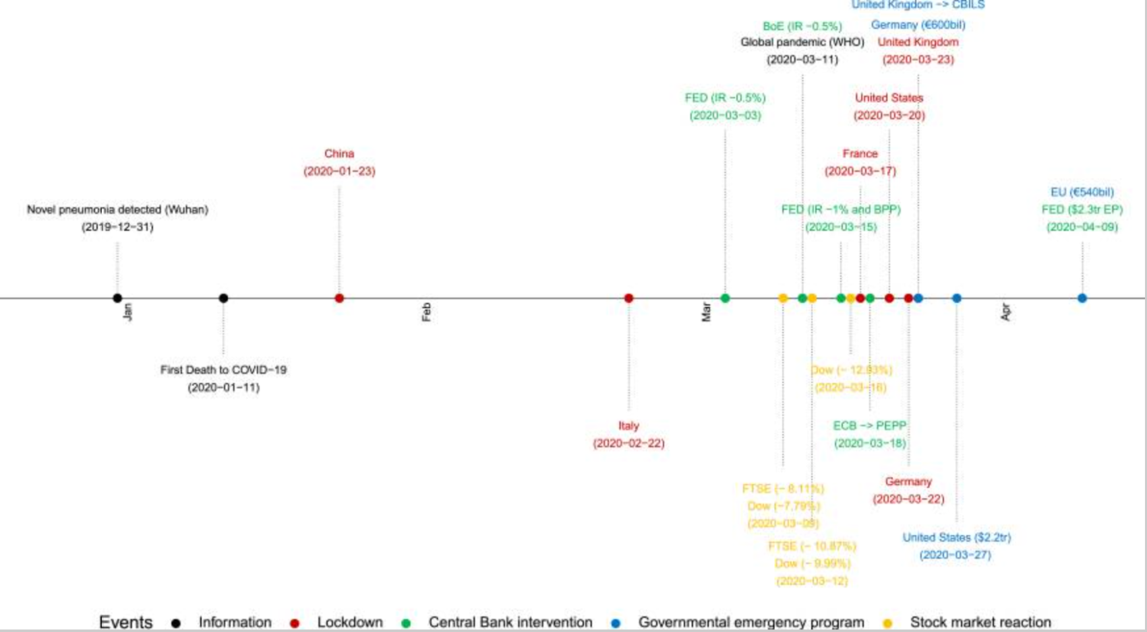
Key Events
Ortman et al. COVID-19 and investor behavior. doi: 10.1016/j.frl.2020.101717
Notes:
These figures are from a research paper on investor behavior during the pandemic, sourced from the NIH
To start off here is a timeline of key events during the investment period
Pandemic was declared by the WHO on March 11th, 2020
The Dow Jones Industrial Average saw a 9.99% drop on March 12th
Lockdowns are in red, the US initiated ours on March 20th - denoting the start of unemployment payments for many
Unemployment increased for workers who could not WFH, reaching a peak of 14.8% in April 2020
Stimulus Payments
CARES Act - April 2020
Consolidated Appropriations Act - Dec 2020 through 2021
American Rescue Plan Act - March 2021

Slide 6
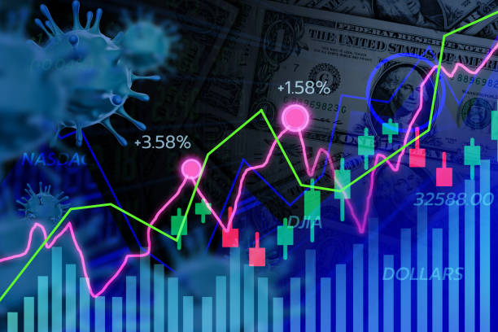
Government Stimulus
Unemployment Payments
Unemployment reached a peak of 14.8% in April 2020
~$600 billion total payments across 3 programs
Stimulus Payments
CARES Act - April 2020
Consolidated Appropriations Act - Dec 2020
American Rescue Plan Act - March 2021
Total Distributed
Over $4 trillion flushed into economy
pandemicoversight.gov
Notes:
All of this money flushed into the system led to speculation in the stock market
There were 3 stimulus payments during our time window
CARES Act (March 2020) - $2.2 trillion
Consolidated Appropriations Act, 2021 (December 2020) - $900 billion
American Rescue Plan Act (March 2021) - $1.9 trillion
https://www.pandemicoversight.gov/news/articles/how-much-money-did-pandemic-unemployment-programs-pay-out

Slide 7
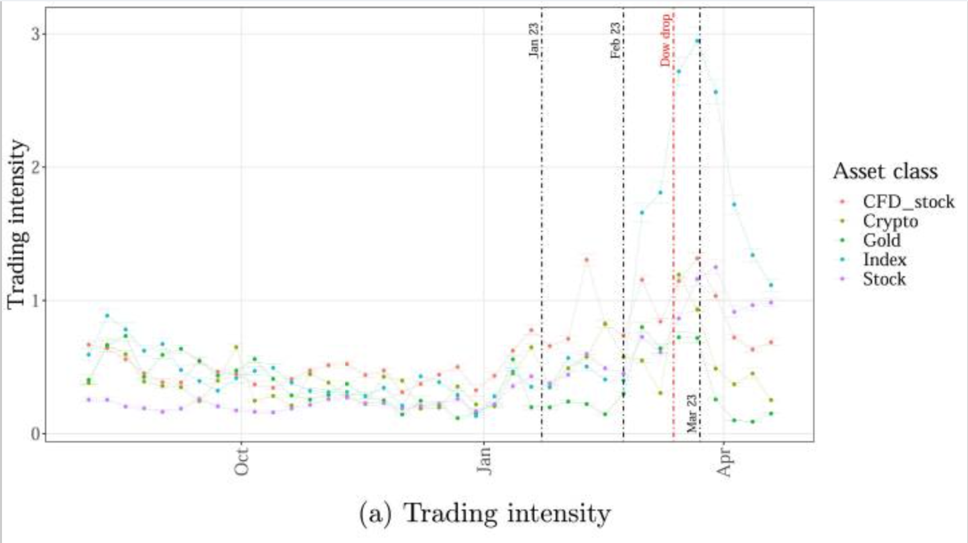
Trading Intensity
Ortman et al. COVID-19 and investor behavior. doi: 10.1016/j.frl.2020.101717
Notes:
Looking at that same timeline, how did the events affect investor behavior
As you can see, speculation and trading intensity increased across all fronts, most significantly in index funds
Investors, on average, increased their brokerage deposits, opened more new accounts, and established more new positions
On average, weekly trading intensity increased by 13.9% as the number of COVID-19 cases doubled throughout the pandemic
Trading intensity denotes the number of trades in a given week

Slide 8
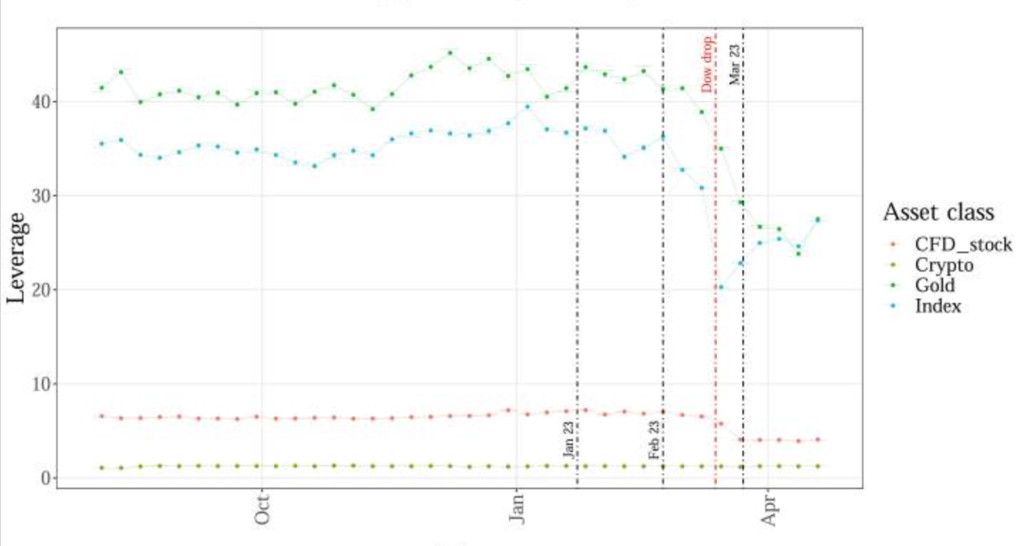
Leverage
Ortman et al. COVID-19 and investor behavior. doi: 10.1016/j.frl.2020.101717
Notes:
One thing to note: while trading increased across the board throughout the pandemic, following the WHO announcement, the dow Jones Industrial Average dropped 10% on March 12th, and as a result investors significantly reduced their usage of leverage, or investing on borrowed money - indicating some caution

Slide 9
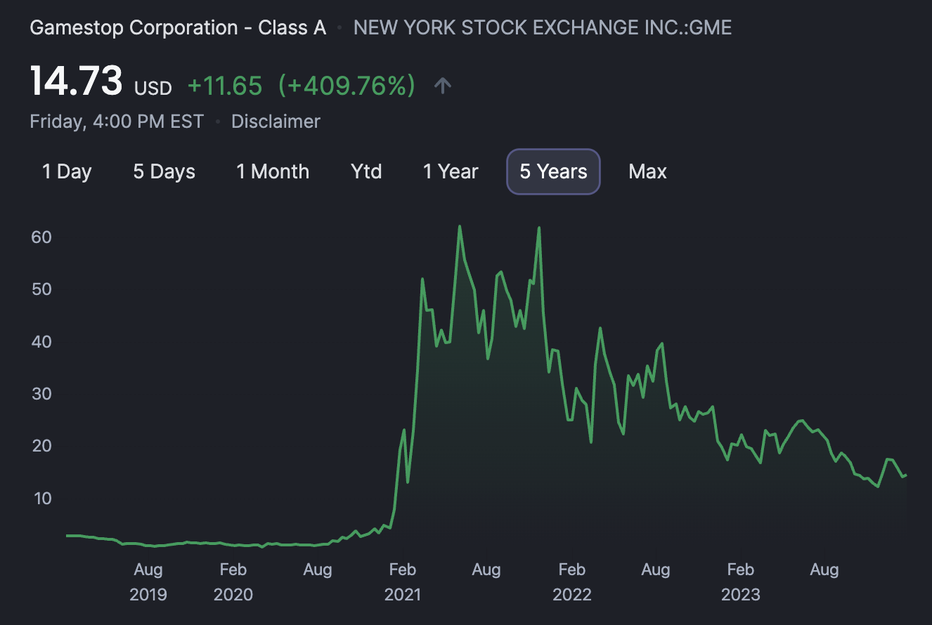
Summary Trends
Increased Investment Activity
Increase in: deposits, new accounts, and new positions
Trading activity positively correlated to COVID cases (13.9% rise per doubling)
Predominantly in male and older investors
Rise of the Retail Investor
Most notably with Gamestop: opened at $5 in 2020 and skyrocketed after retail investors successfully performed a collective short squeeze
CNBC.com
Notes:
Increased trading activity across the board
The historical data shows a correlation between COVID-19 cases and weekly trading intensity. Every time the # of cases doubled, there was, on average, a 13.9% increase in trading
You might think that with the economic uncertainty during the pandemic that investor's risk appetite would shrink and investing would downtrend.
And for some it certainly did, notably seniors and older Americans who turned to government securities and bonds
However, overall investor's appetite for risk notably increased as evidenced by (source)
This is because the government stimulus pumped 4 trillion dollars artificially into the system
After which, we know that young working men with disposable income particularly turned to speculation, especially in cryptocurrencies (lead into Brian's crypto analysis) which were already making quite a buzz (lead in to Wood's twitter analysis)

Slide 10

ETL Methodology

Slide 11
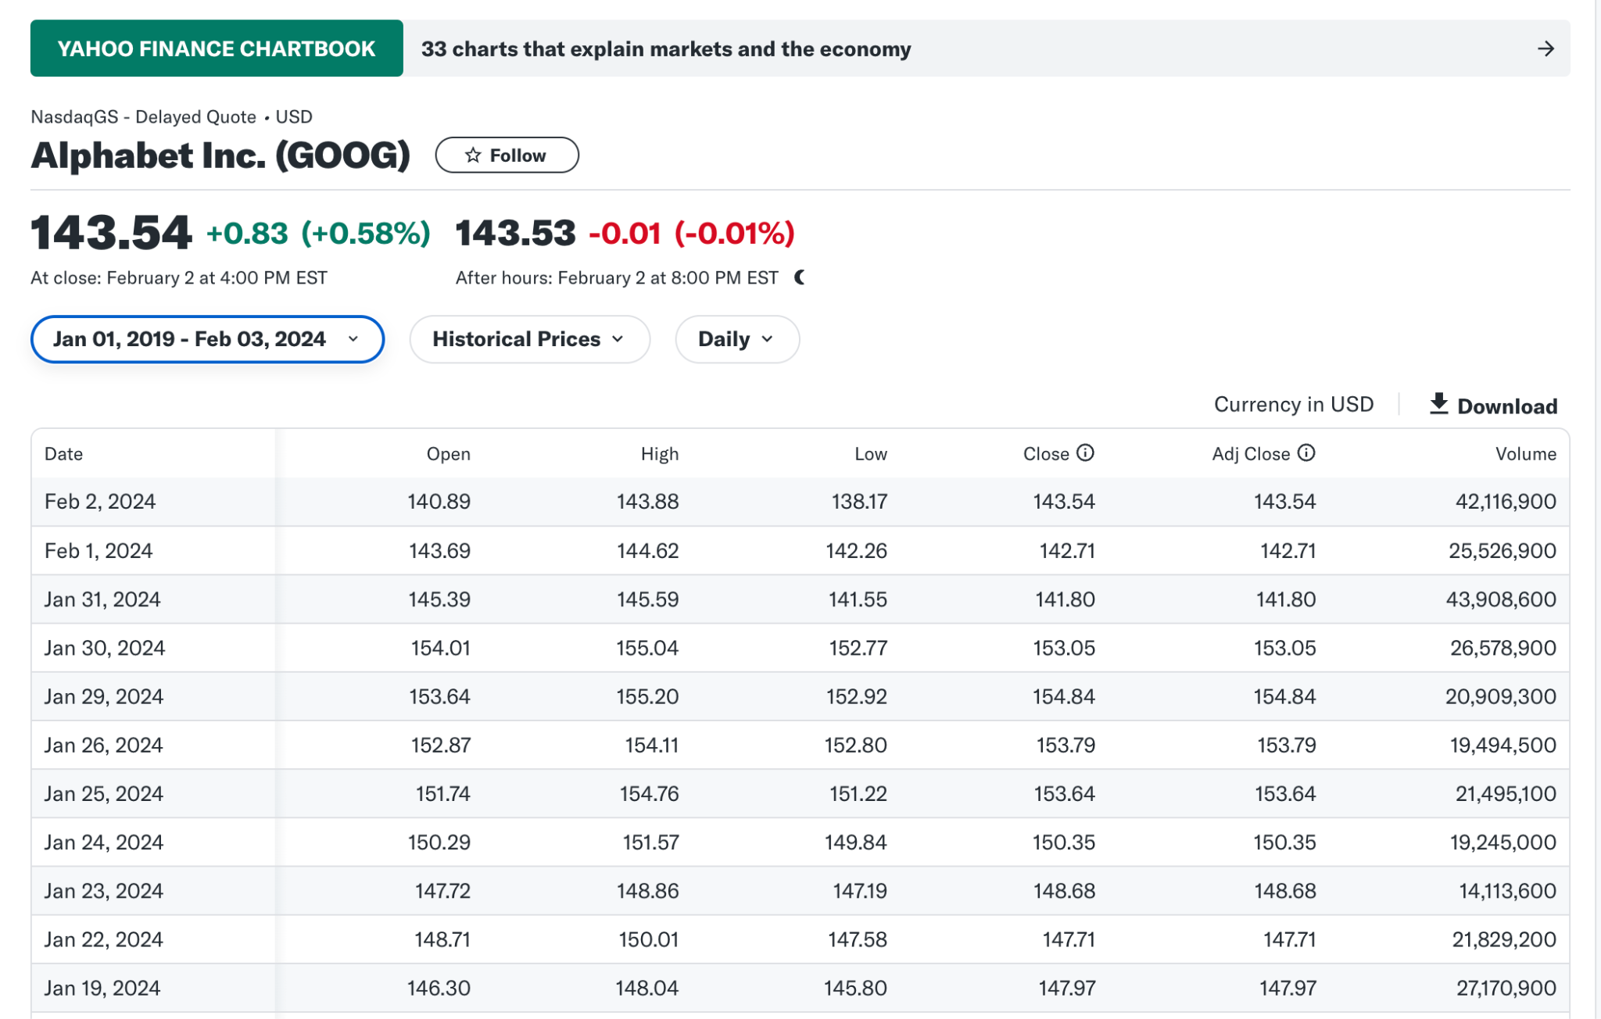
Extract
Data Sources: kaggle.com and finance.yahoo.com
Read CSV data using Pandas and PETL
Identified fields, rows, and columns names

Slide 12
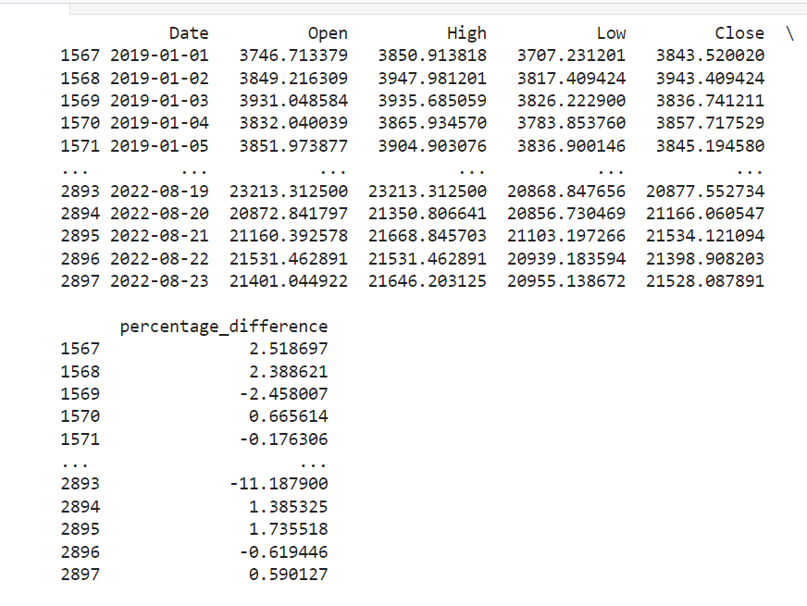
Transform
Cleaned the dataset to prepare for our analysis
Isolated date range of interest (2019-2022)
Dropped columns: Adjusted Close; Volume
Generated new column: Percentage Difference

Slide 13
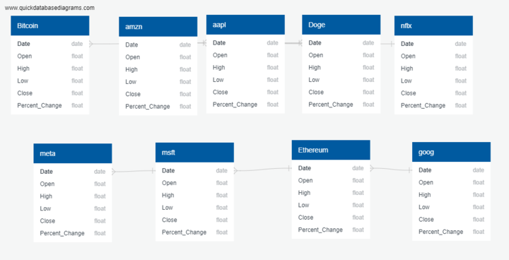
Load
ERD created using QuickDBD
Database created and data files uploaded to PostgreSQL using pgAdmin
Extraction from new db demonstrated using pandas.read_sql functionality

Slide 14
Blue Chip Stocks

Slide 15
What are Blue Chip stocks and FAANG?
Blue Chip stocks are well established, high market share and proven to be profitable companies.
Companies that are viewed as relatively safer investments compared to lesser known startups or volatile investments.
FAANG is one of the most widely known group of Blue Chip stocks consisting of Facebook(META), Apple (AAPL), Amazon (AMZN), Netflix (NFLX) and Alphabet (GOOG formerly Google).
As of August 2023 these 5 stocks alone make up nearly 15% of the S&P 500. Which is an index fund containing the top 500 stocks of the US economy, largely considered an accurate projection of the US economy as a whole.
With the addition of Microsoft, that crosses the 20% marker making them a sizeable portion of the US economy and also with that, remarkably safe investments. (Velasquez, 2023)

Slide 16
Cryptocurrencies

Slide 17
What is Crypto
A cryptocurrency is a digital, encrypted, and decentralized medium of exchange. Unlike the U.S. Dollar or the Euro, there is no central authority that manages and maintains the value of a cryptocurrency. Instead, these tasks are broadly distributed among a cryptocurrency’s users via the internet. The most popular forms of cryptocurrency is Bitcoin and Ethereum.
What Is Cryptocurrency? – Forbes Advisor

Slide 18
Crypto and Stock Market Mapping

Slide 19
Cryptocurrency and Stock Market distribution:
The United States, China, and Japan often lead in crypto market capitalization.
Emerging markets like India and Nigeria show growing interest and adoption.
Regulatory environments impact distribution patterns.
The U.S. dominates the global stock market with a significant share.
Developed economies in Europe and Asia contribute significantly.
Emerging markets play a growing role in global capitalization.
Different countries exhibit varying degrees of involvement in crypto and stock markets
Regulatory frameworks and cultural factors influence the distribution.

Slide 20
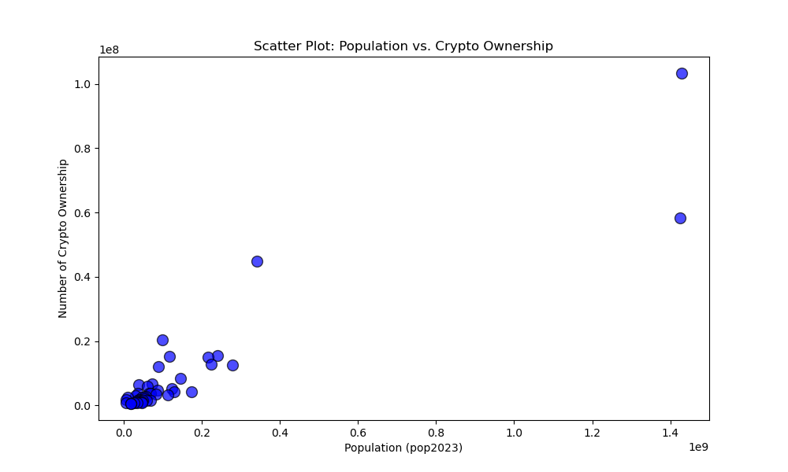
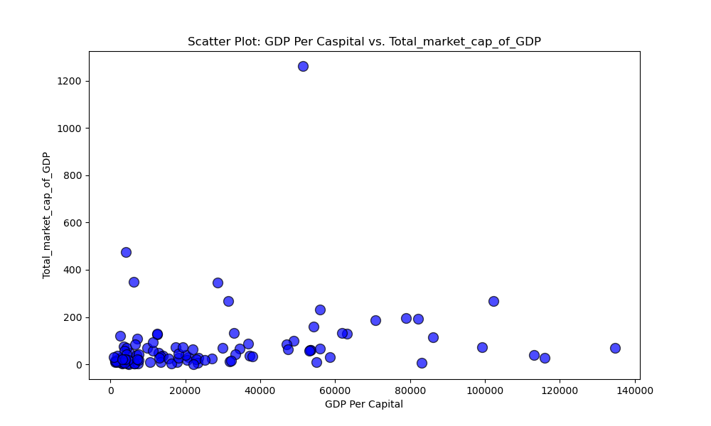
.

Slide 21
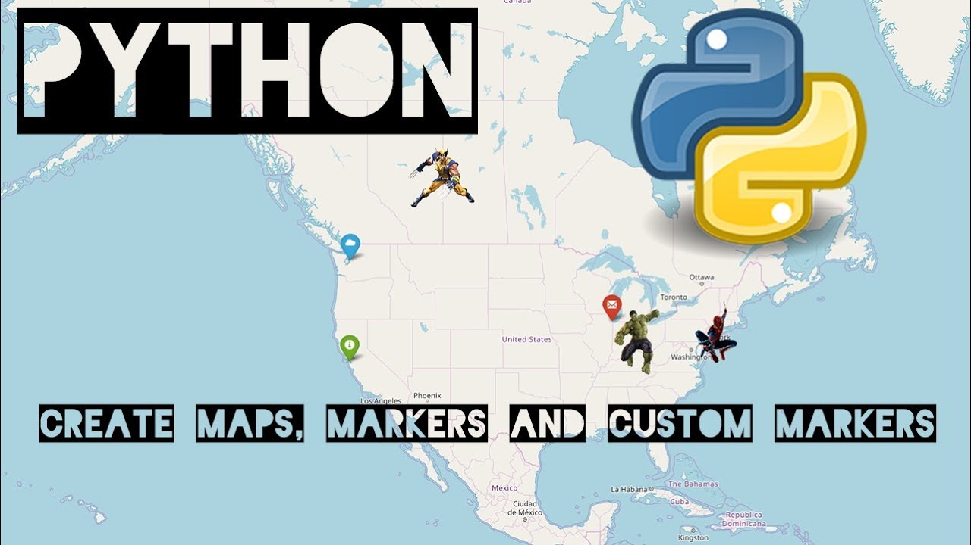
Folium Python library - Mapping
Folium is a Python library for creating interactive maps. It's built on Leaflet and simplifies the process of visualizing geospatial data, allowing users to generate maps with markers, pop-ups, and overlays directly from Python code. It's commonly used in data science and geography for its simplicity and integration with other Python tools.

Slide 22
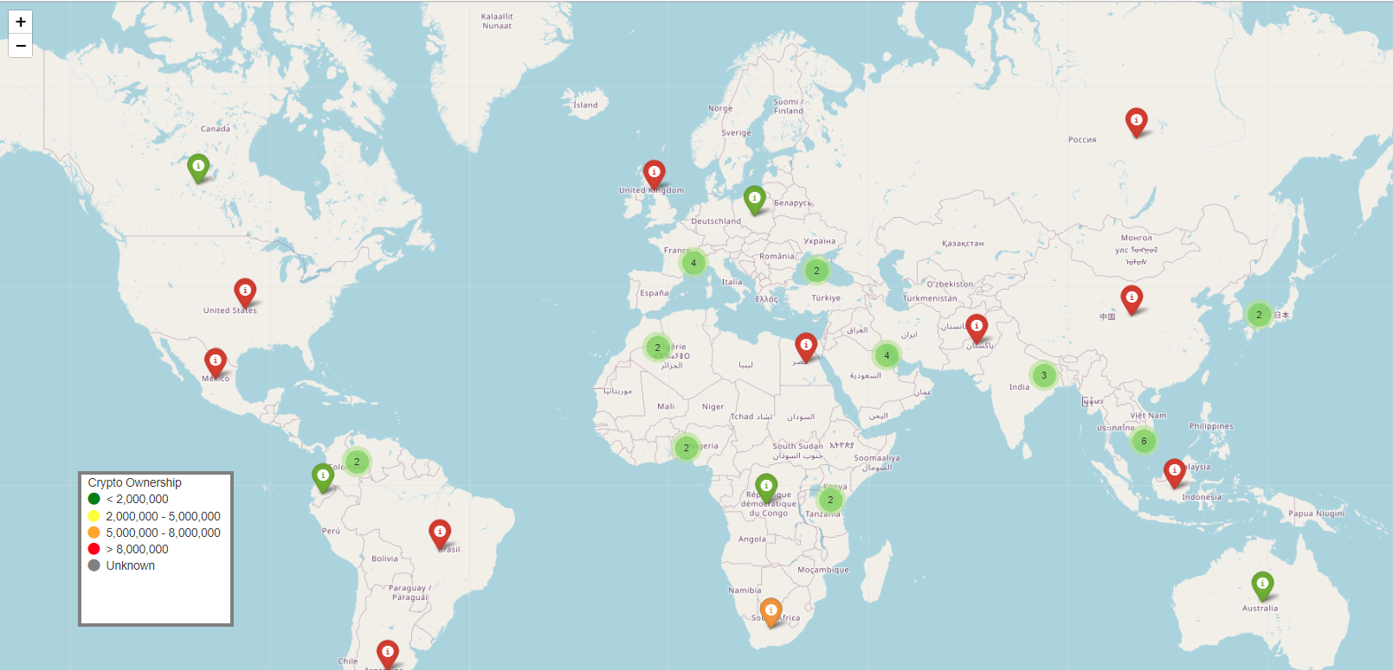
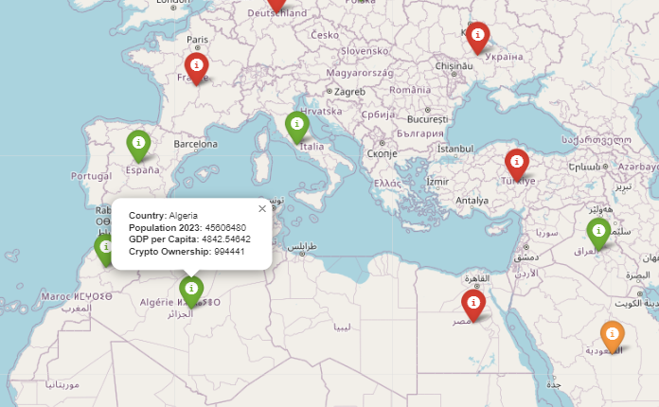
Crypto Mapping
Total Population 2023
Number of Crypto Ownership
46 States

Slide 23
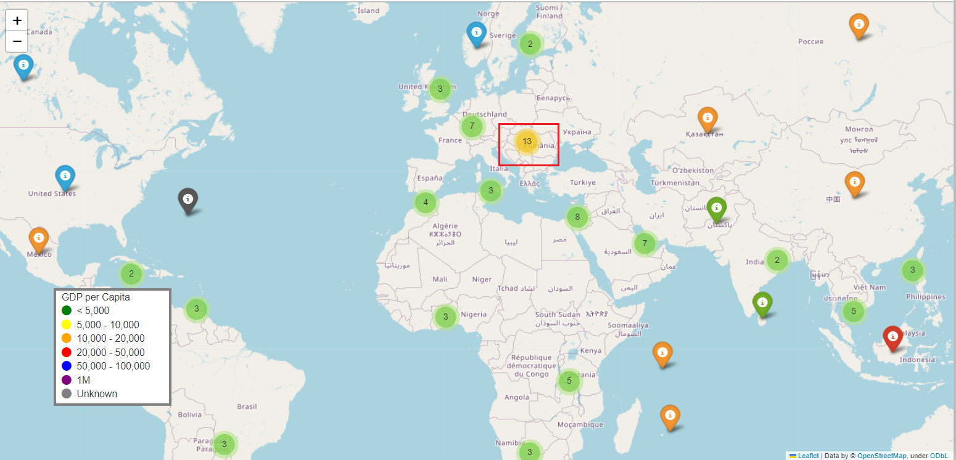
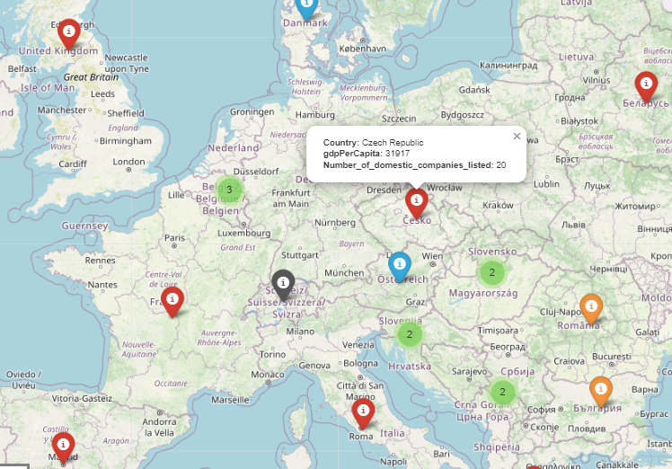
Stock Market Mapping
101 Countries
GDP Per Capita
Total market cap of_GDP
Number of domestic companies listed

Slide 24
Sources
Ortmann R, Pelster M, Wengerek ST. COVID-19 and investor behavior. Finance Research Letters. 2020 Nov;37:101717. doi: 10.1016/j.frl.2020.101717. Epub 2020 Aug 8. PMID: 32837386; PMCID: PMC7414361.
https://www.ncbi.nlm.nih.gov/pmc/articles/PMC7414361/
https://finance.yahoo.com/quote/META/history?p=META
https://www.pandemicoversight.gov/data-interactive-tools/data-stories/update-three-rounds-stimulus-checks-see-how-many-went-out-and
https://www.pandemicoversight.gov/news/articles/how-much-money-did-pandemic-unemployment-programs-pay-out
Ashford, K. (2023, February 16). What is Cryptocurrency? Forbes. https://www.forbes.com/advisor/investing/cryptocurrency/what-is-cryptocurrency/
Velasquez, V. (2023, August 29). Top 10 S&P 500 Stocks by Index Weight. Retrieved from Investopedia: https://www.investopedia.com/top-10-s-and-p-500-stocks-by-index-weight-4843111
https://www.cnbc.com/2021/01/22/gamestop-soars-nearly-70percent-trading-briefly-halted-amid-epic-short-squeeze.html
https://www.forbes.com/advisor/investing/cryptocurrency/what-is-cryptocurrency/

